Slide 1
Airfoil Self-Noise prediction
SCS3253 - Machine Learning Project - Group I

Slide 2
Agenda
Introduction
Exploration
Scikit-learn Models
Neural network Models
Summary

Slide 3
Airfoil Self-Noise Dataset

Slide 4
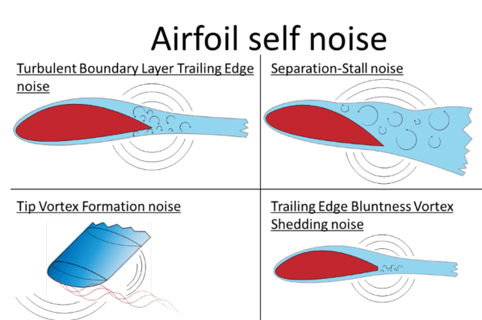
Airfoil Self-Noise Data Set
The NASA data set comprises different size NACA 0012 airfoils at various wind tunnel speeds and angles of attack.
The span of the airfoil and the observer position were the same in all of the experiments.
https://www.researchgate.net/figure/leftSketch-of-airfoil-self-noise-mechanisms-right-methodology-of-the-IBPM-model_fig2_308841044

Slide 5
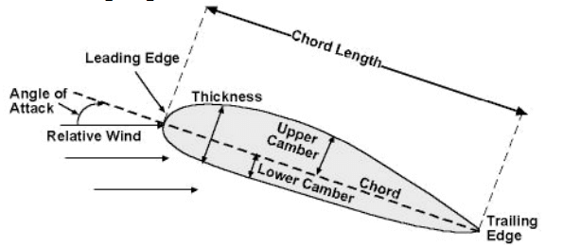
Airfoil Self-Noise Data Set
The NASA data set was obtained from a series of aerodynamic and acoustic tests of two and three-dimensional airfoil blade sections.
https://www.researchgate.net/figure/leftSketch-of-airfoil-self-noise-mechanisms-right-methodology-of-the-IBPM-model_fig2_308841044

Slide 6
Objective
Investigating the associations among all features and target.
Practicing data preprocessing.
Searching for the better fitting model.

Slide 7
Exploration

Slide 8
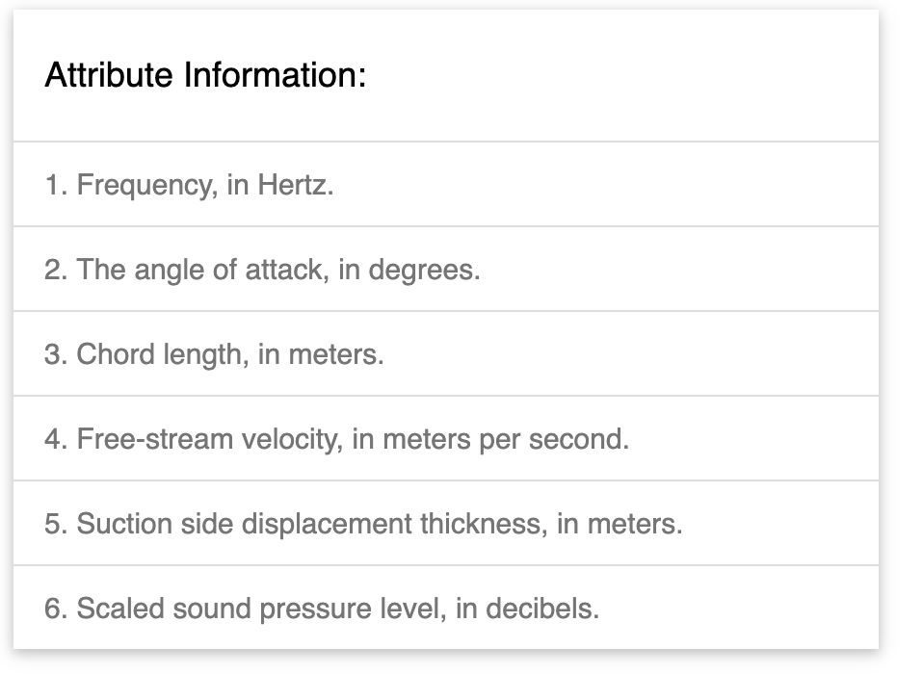
Attributes
There are 5 features and 1 target
The target is scaled sound pressure level, in decibels.

Slide 9
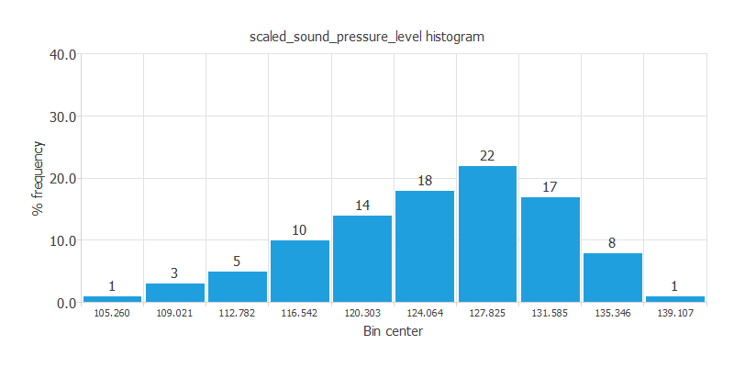
Exploration - target
https://www.neuraldesigner.com/learning/examples/airfoil-self-noise-prediction#ModelSelection

Slide 10
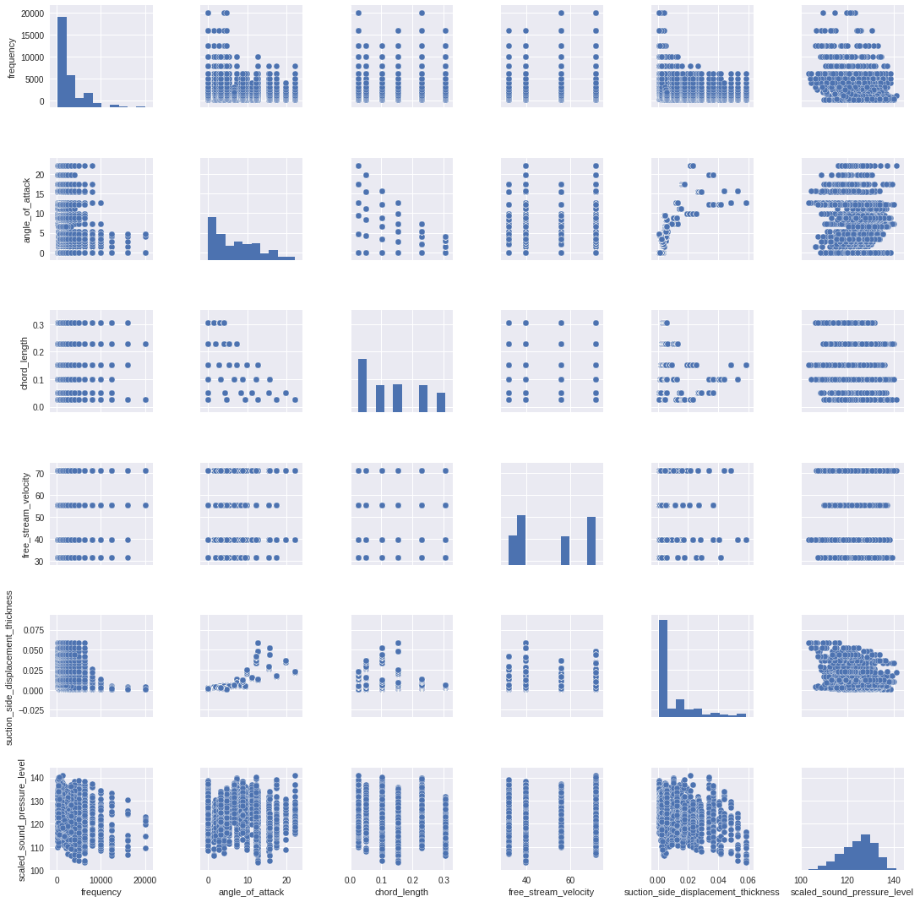
Exploration - features
There are 5 features and 1 target
The target is scaled sound pressure level, in decibels.

Slide 11
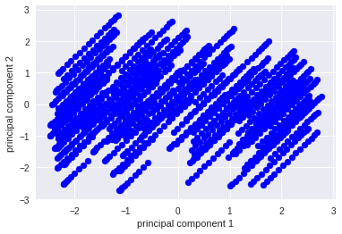
Dimensionality reduction - PCA

Slide 12
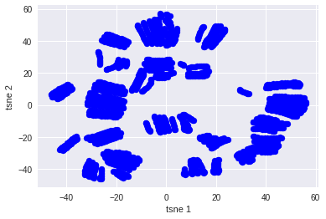
Dimensionality reduction - T-SNE

Slide 13
Model Selection

Slide 14
Transformations and tuning
Quantile transformer: This method transforms the features to follow a uniform or a normal distribution.
Max Abs scaler: Scale each feature by its maximum absolute value.
Standard scaler: Standardize features by removing the mean and scaling to unit variance.
GridSearchCV: Exhaustive search over specified parameter values for an estimator.

Slide 15
Model Selection
Lasso
Linear regression
Bayesian Ridge
Ridge
ElasticNet
SVR
Neural network

Slide 16
GitHub
GitHub page and project
To the code

Slide 17
Results

Slide 18
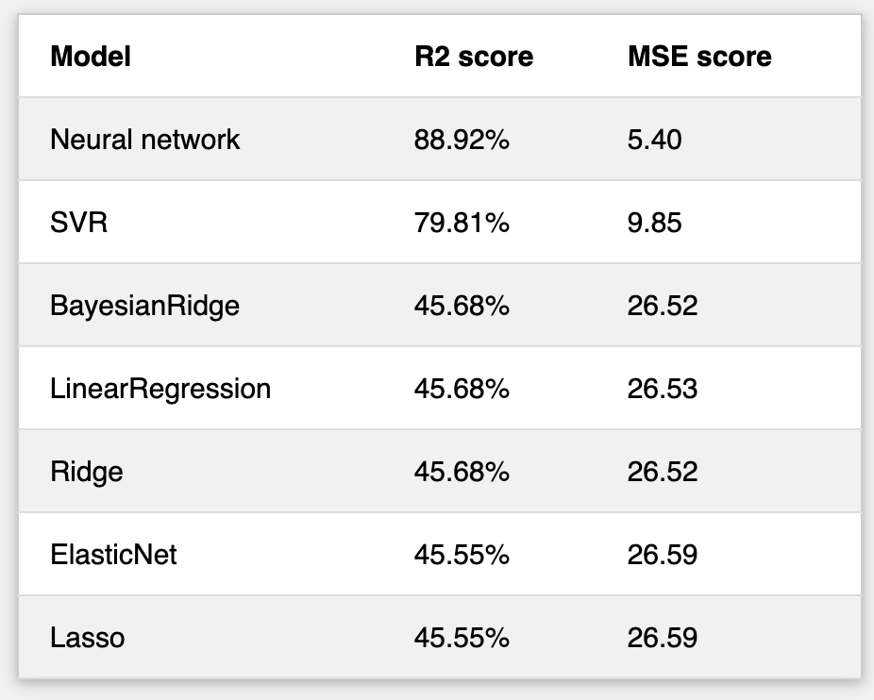
Results

Slide 19
88%
The best accuracy using a neural network

Slide 20
Conclusions & Recommendations
Epsilon-Support Vector Regression (SVR)
R square score = 0.80
Neural Network model is predicting well the entire range of sound level data
R square score = 0.88

Slide 21

Thank you

